Slide 1
Covered Topics
Linear Regression
Polynomial Regression
Logistic Regression
Cost Function
Gradient Descend
Feature Scaling
Regularization
PCA
LDA
NN
SVM
K-Means
Hierarchical
Kernels
Anomaly Detection
Multivariate Gaussian Distribution

Slide 2
Machine Learning

Slide 3
Supervised Learning
Training Set (m samples)
(y, x)
Learning Algorithm
Test Data (x)
Hypothesis (h)
Output (y)

Slide 4
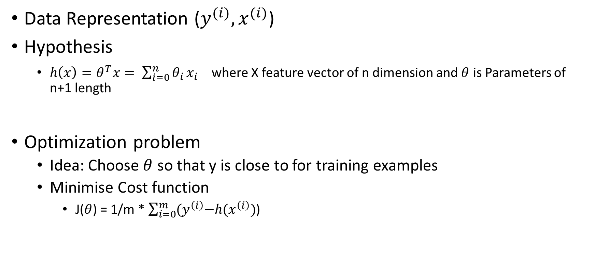
Linear Regression
Dependent Variable
Data Representation ($y^{(i)}, x^{(i)}$)
Hypothesis
$h\left(x\right)=θ^{T}x= \sum_{i=0}^{n}{θ_{i}}x_{i}$ where X feature vector of n dimension and $θ$ is Parameters of n+1 length
Optimization problem
Idea: Choose $θ$ so that y is close to for training examples
Minimise Cost function
J($θ$) = 1/m * $\sum_{i=0}^{m}{{(y}^{\left(i\right)}−{h(x}^{\left(i\right)})}$)
Independent Variable

Slide 5
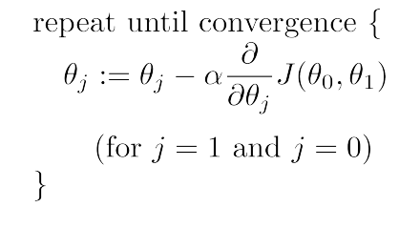
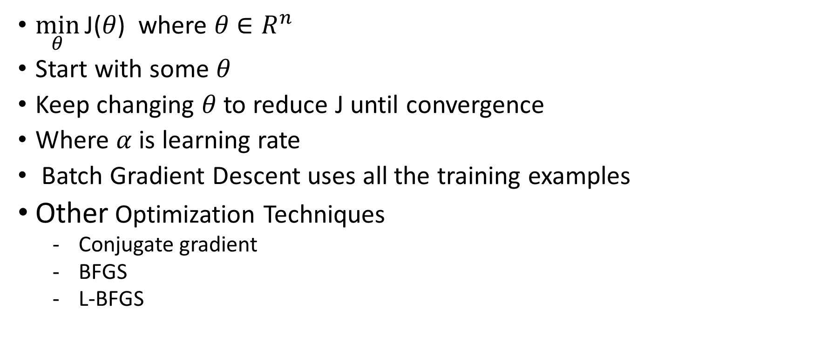
Gradient descent
$\min_{θ}{\text{J}\text{(}θ\text{)}}$ where $θ$ $∈R^{n}$
Start with some $θ$
Keep changing $θ$to reduce J until convergence
Where $α$is learning rate
Batch Gradient Descent uses all the training examples
Other Optimization Techniques
Conjugate gradient
BFGS
L-BFGS

Slide 6
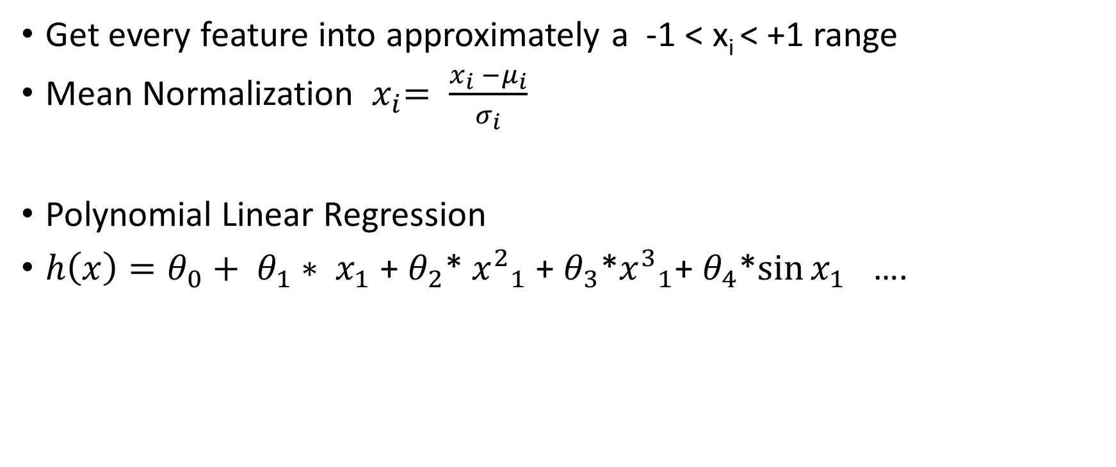
Feature Scaling
Get every feature into approximately a -1 < x_{i} < +1 range
Mean Normalization ${ x}_{i}= \frac{x_{i} −μ_{i}}{σ_{i}}$
Polynomial Linear Regression
$h\left(x\right)=θ_{0}+ θ_{1}∗ x_{1}$ + $θ_{2}$* ${x^{2}}_{1}$ + $θ_{3}$*${x^{3}}_{1}$+ $θ_{4}$*${\sin{x_{1}}}_{}$….

Slide 7
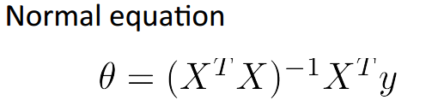
Normal Equation (Mean Square Method)

Slide 8
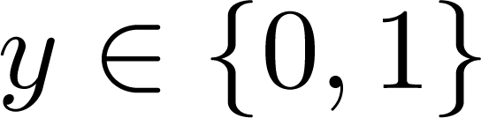

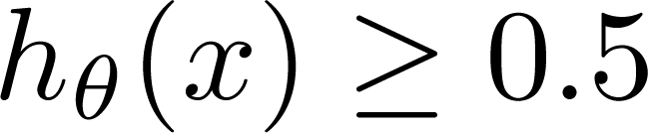
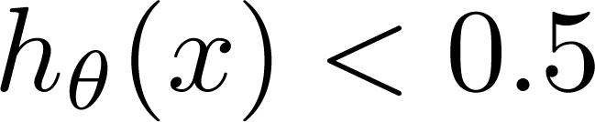
Classification
0: “Negative Class”
1: “Positive Class”
Threshold classifier output at 0.5:
If , predict “y = 1”
If , predict “y = 0”

Slide 9
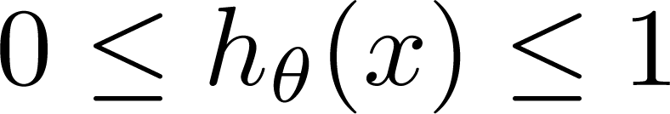
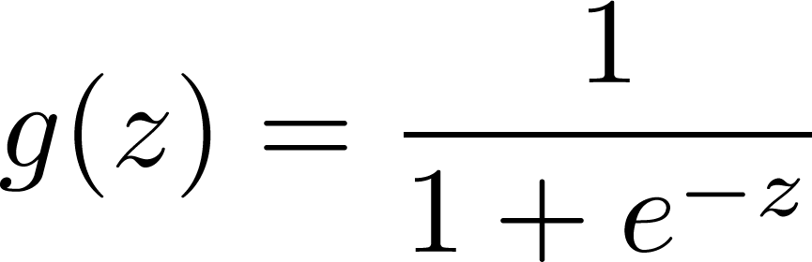
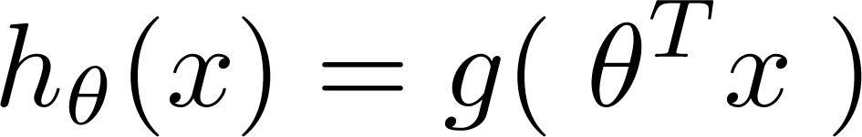


Logistic Regression:
Logistic Regression:
1
If g(z) >= 0.5 then class is +ve
i.e. $θ^{T}x$ >= 0
If g(z) < 0.5 then class is -ve
i.e. $θ^{T}x$ < 0
Sigmoid function
Logistic function
0.5
z

Slide 10
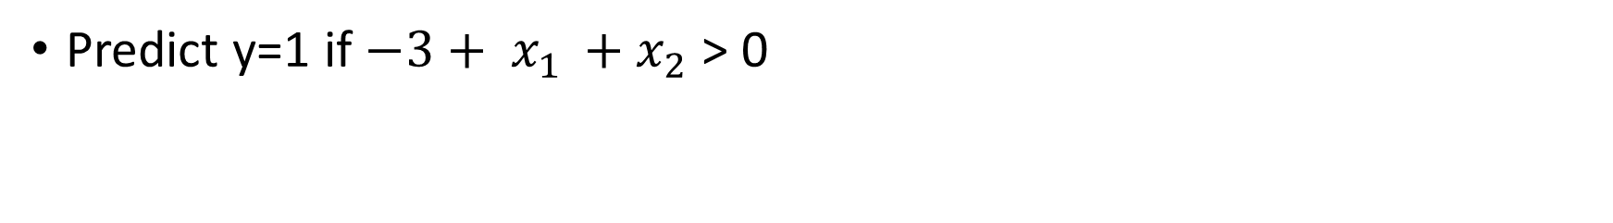
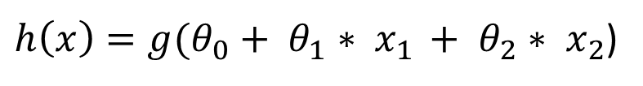
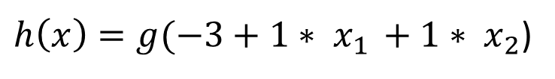
Decision Boundary
x₂
$h\left(x\right)={g(θ}_{0}+ θ_{1}∗ x_{1 }+ θ_{2}∗ x_{2}$)
3
$h\left(x\right)=g(−3+1∗ x_{1 }+1∗ x_{2}$)
2
1
1
2
3
x₁
Predict y=1 if $−3+ x_{1 }+x_{2}$ > 0

Slide 11
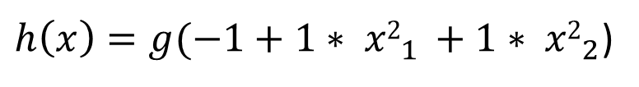
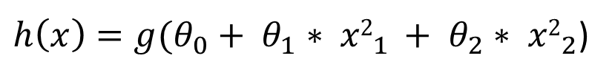
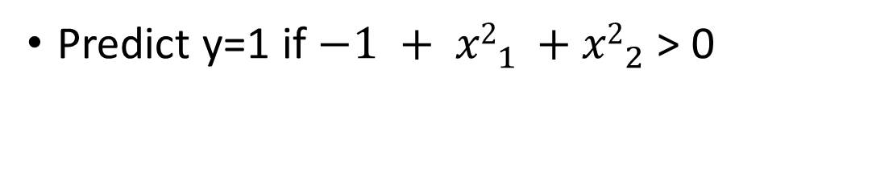
Non linear data
1
$h\left(x\right)={g(θ}_{0}+ θ_{1}∗ {x2}_{1 }+ θ_{2}∗ {x2}_{2}$)
1
x₁
-1
$h\left(x\right)=g(−1+1∗ {x2}_{1 }+1∗ {x2}_{2}$)
-1
x₂
Predict y=1 if $−1 + {x2}_{1 }+{x2}_{2}$ > 0

Slide 12
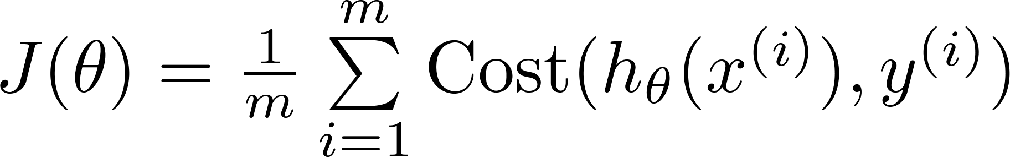
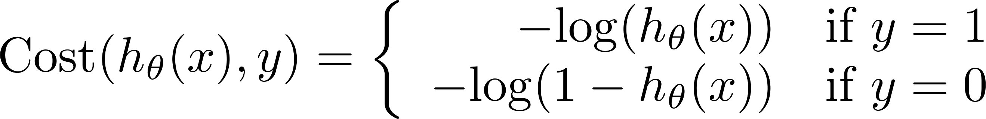
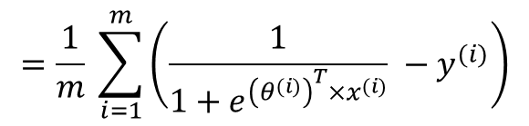






Logistic regression cost function
$J(θ)$
$θ$
Not guaranty to get global minima
$$=\frac{1}{m} \sum_{i=1}^{m}{\left(\frac{1}{1+e^{{\left(θ^{(i)}\right)}^{T}×x^{(i)}}} −y^{(i)}\right)}$$
$J(θ)$
0
1
$h_{θ}(x)$
$J(θ)$
$h_{θ}(x)$
0
1

Slide 13
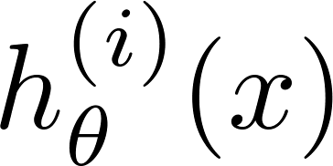
Multiclass
One vs All
Take One Class (i) as +ve and all others are –ve
Train a logistic regression classifier for each class i to predict the probability that .
On a new input x , to make a prediction, pick the class i that maximizes

Slide 14

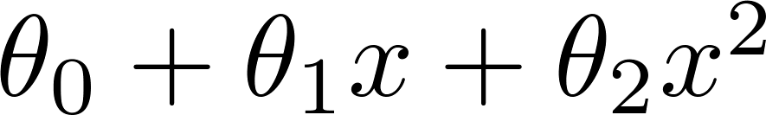
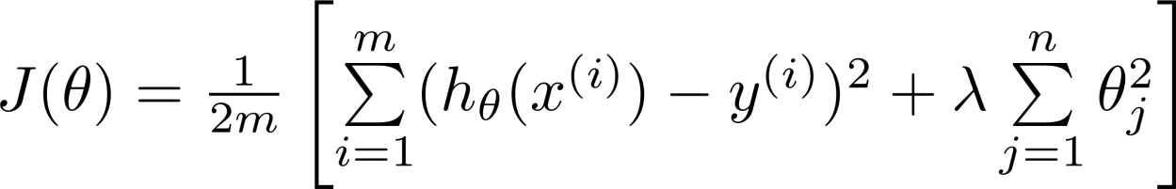
Regularization
00
Price
Price
Price
Size
Size
Size
Under fitting
Proper fitting
Over fitting

Slide 15
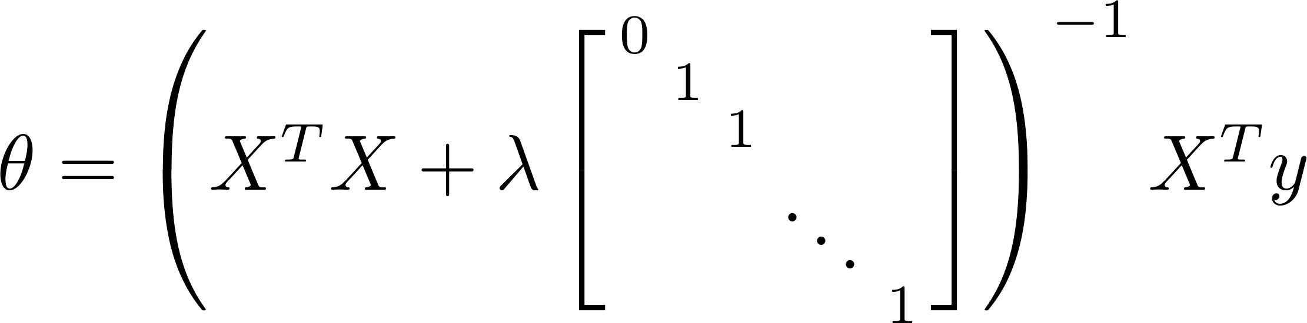
Normal Equation

Slide 16










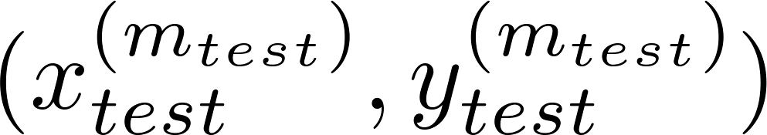
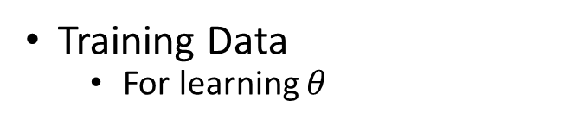

Evaluating your hypothesis
Training Data
For learning $θ$
(cross validation
error)
error
Cross validation Data
For choosing training Parameters
$$λ, α, ε$$
(training error)
Testing Data
Get accuracy
degree of polynomial d

Slide 17
Unsupervised Learning

Slide 18


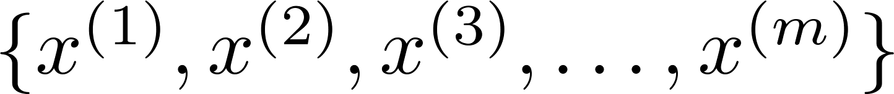
Clustering
Training Data

Slide 19

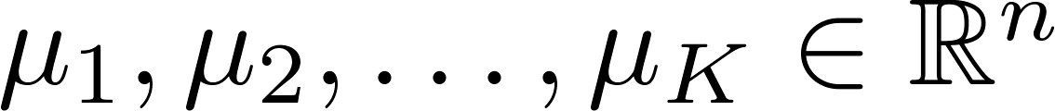



K-Means Clustering
Randomly initialize cluster centroids
Repeat {
for = 1 to
:= index (from 1 to ) of cluster centroid
closest to
for = 1 to
:= average (mean) of points assigned to cluster
}

Slide 20
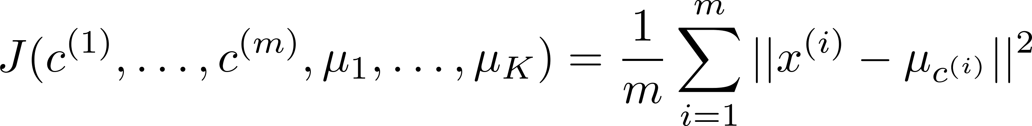
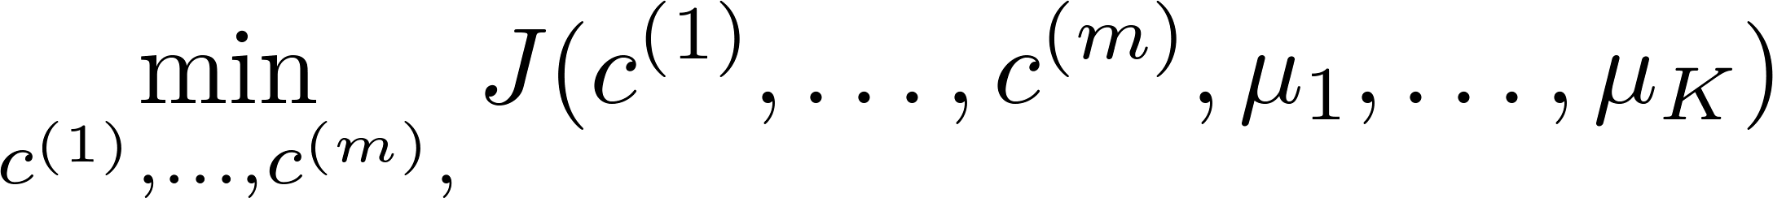

Optimization Objective

Slide 21
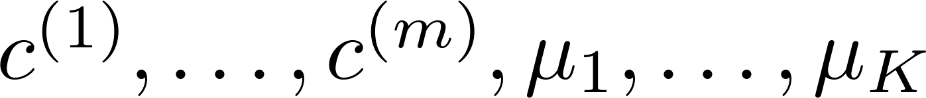
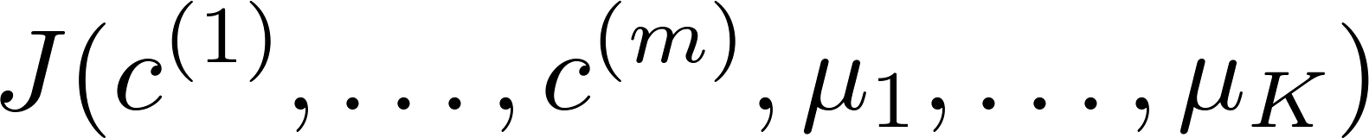
Random initialization
For i = 1 to 100 {
Randomly initialize K-means.
Run K-means. Get .
Compute cost function (distortion)
}
Pick clustering that gave lowest cost

Slide 22


Choosing the value of K
Elbow method:
Cost function
(no. of clusters)

Slide 23

Hierarchical Clustering
D
F
Training Data
E
A
C
Distance Matrix $D^{ij}=\left\|x^{(i)}−x^{(j)}\right\|2$ $∀ i\&j, i≠j$
B
a b c d e f
a b c df e
ab c df e
a
b
c
d
e
f
a
b
c
df
e
ab
c
df
e
0 | 7 | 56 | 36 | 42 | 32
 | 0 | 49 | 29 | 35 | 25
 |  | 0 | 22 | 14 | 25
 |  |  | 0 | 10 | 5
 |  |  |  | 0 | 12
 |  |  |  |  | 0
0 | 7 | 56 | 32 | 42
 | 0 | 49 | 25 | 35
 |  | 0 | 22 | 14
 |  |  | 0 | 10
 |  |  |  | 0
0 | 49 | 25 | 35
 | 0 | 22 | 14
 |  | 0 | 10
 |  |  | 0
$$D^{ij}=$$

Slide 24
Dendogram
25
20
D
F
15
E
A
C
10
B
5
d f e c a b

Slide 25

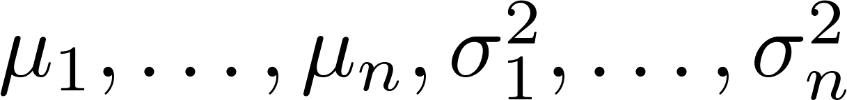
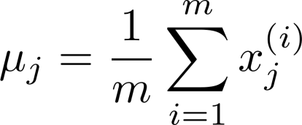
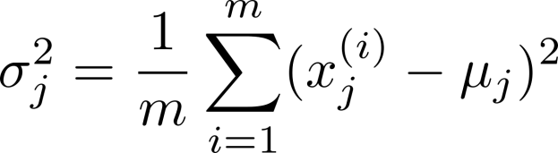


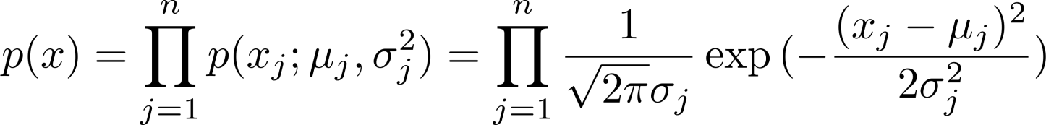
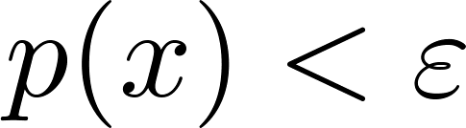
Anomaly detection
Choose features that you think might be indicative of anomalous examples.
Fit parameters
Given new example , compute :
Anomaly if

Slide 26
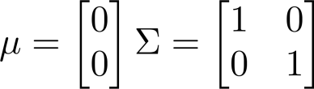
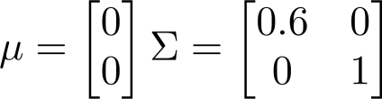
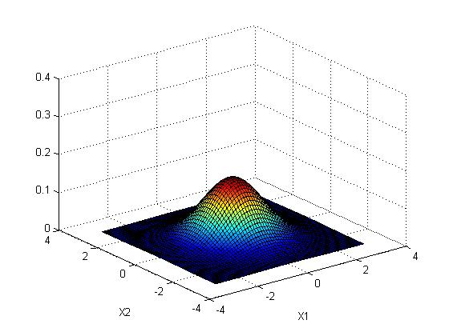
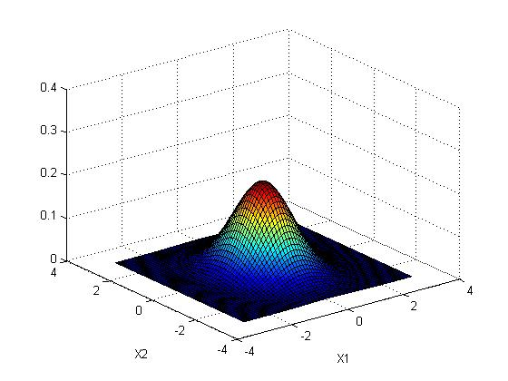


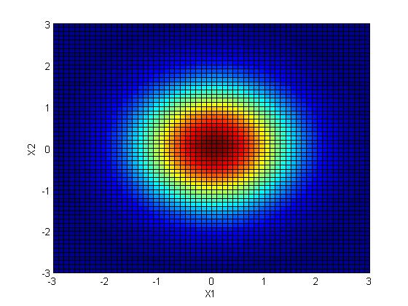
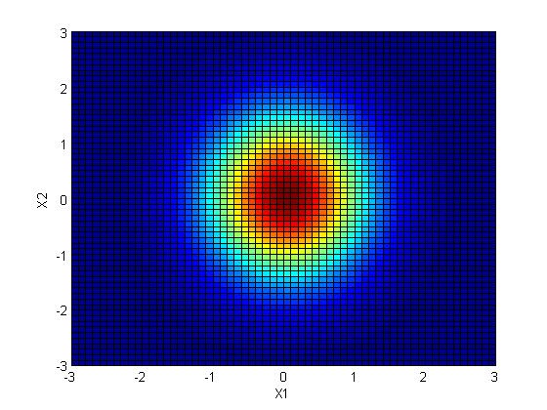
Multivariate Gaussian Distribution

Slide 27
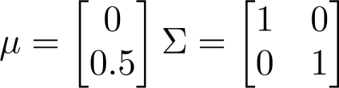
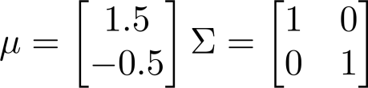
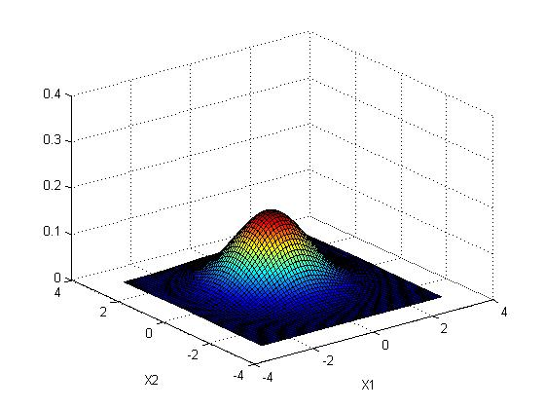
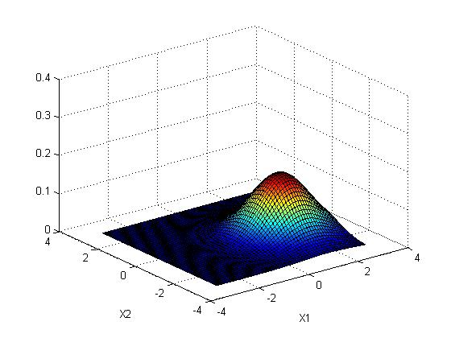
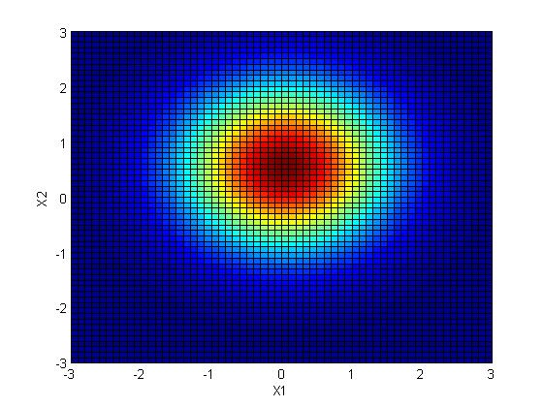
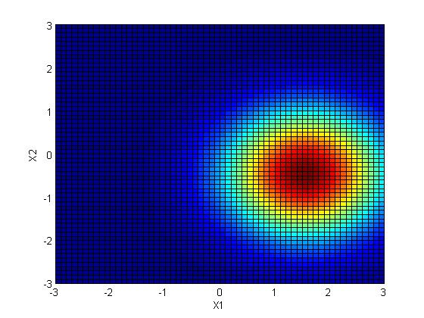

Slide 28





Multivariate Gaussian Distribution
Parameters
Training Data set

Slide 29







Principal Component Analysis (PCA)
(inches)
(cm)

Slide 30









PCA
Reduce data from -dimensions to -dimensions
Compute “covariance matrix”:
$x^{i}$ $∈ R^{n ×1}$
Compute “eigenvectors” of matrix :
[U,S,V] = svd(Sigma);
$z^{i}= U_{k}^{T}∗ x^{i}$
$z^{i}$ $∈ R^{k ×1}$
k Principle Component -> $U_{k }∈R^{n ×k}$

Slide 31


Recovering From PCA
$z^{(i)}= U_{k}^{T}∗ x^{(i)}$
$x_{approx}^{(i)}$= $U_{k }× z^{(i)}$

Slide 32


How to select k components
$z^{(i)}= U_{k}^{T}× x^{(i)}$
$x_{approx}^{(i)}$= $U_{k }× z^{(i)}$
Typically, choose to be smallest value so that
“99% of variance is retained”
(1%)

Slide 33

Linear Discriminant Analysis
LDA seeks to reduce dimensionality while preserving as much of the class discriminatory information as possible
PCA
LDA
CSCE 666 Pattern Analysis | Ricardo Gutierrez-Osuna | CSE@TAMU

Slide 34

LDA
Rule: Assign data point to the class with highest conditional probability (Bayes Rule)
Assign data point to class i where $P\left(i | x\right)>P\left(j | x\right), for ∀ j ≠i$
$P\left(i | x\right)$ probability data belong to class i given measurement x
$P\left(i | x\right)= \frac{P\left(x | i\right) ∗p(i)}{\sum_{∀j}{P\left(x | j\right) ∗p(j)}}$
To use Bayes rule directly is unpractical $P\left(x | i\right)$
If we assume that each class has Multivariate Normal Distribution and all class have the same covariance matrix (LDA)
$f_{i}=μ_{i}C^{−1}x_{k}^{T}−\frac{1}{2}μ_{i}C^{−1}μ_{i}^{T}+ln⁡(p_{i})$

Slide 35

Neural Network
[Credit: US National Institutes of Health, National Institute on Aging]

Slide 36


Non Linear Data
x₂
x₂
x₁
x₁

Slide 37













Simple example: AND
1
0.5
z
$θ_{10}^{1}=$ -30
$θ_{11}^{1}=$ 20
$$a_{1}^{2}$$
0 | 0 | $$g\left(−30\right)≈0$$
0 | 1 | $$g\left(−10\right)≈0$$
1 | 0 | $$g\left(−10\right)≈0$$
1 | 1 | $$g\left(20\right)≈0$$
$θ_{12}^{1}=$ 20
$h_{θ}\left(x\right)=g(−30+20∗ x_{1 }+20∗ x_{2}$)

Slide 38







XNOR
-30
10
-10
20
-20
20
20
-20
20
$$a_{0}^{2}$$
-30
20
-10
$$a_{1}^{2}$$
20
$$a_{1}^{3}$$
20
10
20
-20
$$a_{2}^{2}$$
-20
Layer 1
Layer 2
Layer 3

Slide 39








Neural Network (Classification)
total no. of layers in network
no. of units (not counting bias unit) in layer
Layer 1
Layer 2
Layer 3
Layer 4
Binary classification
1 output unit
Multi-class classification (K classes)
K output units
E.g. , , ,
pedestrian car motorcycle truck

Slide 40



Cost function
Logistic regression:
Neural network:

Slide 41















Gradient computation : Forward propagation
Given one training example ( , ):
$$a^{1}=x$$
$$a^{2}$$
$$a^{3}$$
$$a^{4}= h_{θ}(x)$$
Layer 1
Layer 2
Layer 3
Layer 4

Slide 42






Gradient computation: Backpropagation algorithm
Intuition: “error” of node in layer .
For each output unit (layer L = 4)
Layer 1
Layer 2
Layer 3
Layer 4
Where $g^{′}\left(z^{\left(3\right)}\right)=a^{3}.∗(1−a^{3})$
Where $g^{′}\left(z^{\left(2\right)}\right)=a^{2}.∗(1−a^{2})$
$$\frac{∂J(θ)}{∂θ_{ij}^{(l)}}=a_{j}^{(l)}δ_{i}^{(l+1)}$$

Slide 43














Backpropagation algorithm
Training set
Set (for all ).
For
Set;
Perform forward propagation to compute for
Using , compute
Compute

Slide 44
Support Vector Machine (SVM)

Slide 45














Logistic regression
If , we want ,
If , we want ,
Cost of example:

Slide 46







Logistic regression
$${cost}_{1}(z)$$
$${cost}_{0}(z)$$
SVM
If , we want (not just )
If , we want (not just )

Slide 47


Vector Inner Product
v
v₂
u
u₂
p
v₁
u₁
$$u^{T}v=p.\left\|u\right\|$$

Slide 48








Large Margin Intuition
Consider C is very large, then optimization problem becomes
$$\underset{θ}{=min}{\frac{1}{2}\left\|θ\right\|}$$
s.t. $p.\left\|θ\right\|≥1 if y^{\left(i\right)}=1$
$p.\left\|θ\right\|≤1 if y^{\left(i\right)}=0$
x
x₂
$$θ$$
$θ$₂
p
$θ$₁
u₁

Slide 49














$$\min_{θ}{\frac{1}{2}\left\|θ\right\|}$$
s.t. $p.\left\|θ\right\|≥1 if y^{\left(i\right)}=1$
$p.\left\|θ\right\|≤1 if y^{\left(i\right)}=0$
Decision Boundary
Decision Boundary
$$x^{(2)}$$
$$p^{(1)}$$
$$x^{(2)}$$
$$p^{(1)}$$
$$θ$$
$$p^{(2)}$$
$$x^{(1)}$$
$$p^{(2)}$$
$$x^{(1)}$$
Here $p^{(1)}$ is small, $\left\|θ\right\|$ will be large, Decision Boundary is not good
Here $p^{(1)}$ is bigger, $\left\|θ\right\|$ will be Smaller, Decision Boundary is good

Slide 50



Kernel
Non-linear Decision Boundary
x₂
x₁
Is there a different / better choice of the features ?

Slide 51








Similarity from Landmarks
$$l^{(1)}$$
$$l^{(2)}$$
x₂
x
$$l^{(3)}$$
x₁
$$f_{1}=exp\left(−\frac{\left\|x−l^{(1)}\right\|2}{2σ^{2}}\right)$$
$$f_{2}=exp\left(−\frac{\left\|x−l^{(2)}\right\|2}{2σ^{2}}\right)$$
$$f_{3}=exp\left(−\frac{\left\|x−l^{(3)}\right\|2}{2σ^{2}}\right)$$
Kernel Regression :
Predict if
Kernel PCA :
Compute covariance and Eigen Values using $f_{2}$

Slide 52










Landmarks ?
$$l^{(1)}$$
$$l^{(3)}$$
$$l^{(2)}$$
$$l^{(4)}$$
$$l^{(5)}$$
$$l^{(m)}$$
For training example ($x^{(i)},y^{(i)}$) :
$$f_{1}^{(i)}=exp\left(−\frac{\left\|x^{(i)}−l^{(1)}\right\|2}{2σ^{2}}\right)$$
$$f_{2}^{(i)}=exp\left(−\frac{\left\|x^{(i)}−l^{(2)}\right\|2}{2σ^{2}}\right)$$
$$f_{m}^{(i)}=exp\left(−\frac{\left\|x^{(i)}−l^{(1)}\right\|2}{2σ^{2}}\right)$$

Slide 53
Remaining Topics
Decision Tree
Random Forest
Hidden Markov Model
Genetic Algorithm
Convolution Neural Network
Kalman Filtering
Particle Filtering

